Slide 1

Fine Tuning Model

Slide 2




My Bio
Experience :
Data Scientist at Jabar Digital Service
Data Science Tutor at Shift Academy
Business Intelligence Analyst at Jabar Digital Service
Owner and Consultant at Barz Data Consultant
Data Scientist at IYKRA
Data Analyst at BAPPEDA Sukoharjo
Data Analyst at PT. Arah Environmental
www.linkedin.com/in/akbar-maulana/
akbar.maulana2298@gmail.com

Slide 3

Model Validation

Slide 4
A basic method of evaluation is model validation on a different, independent data set from the same source, i.e. on testing data.

Slide 5
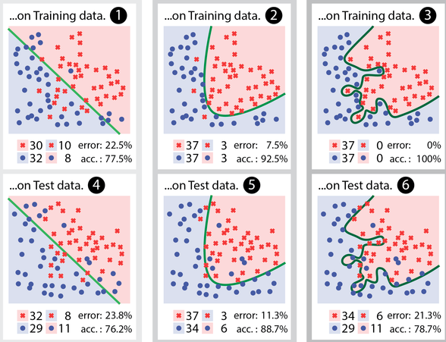
Model Validation

Slide 6
Model Validation

Slide 7
Model Validation

Slide 8
Becareful
Underfitting and Overfitting

Slide 9
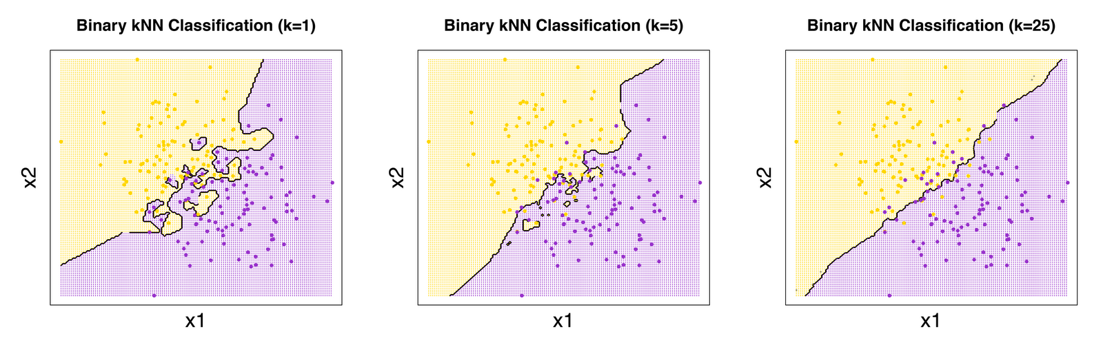
If the model is too simple, the solution is biased and does not fit the data.
If the model is too complex then it is very sensitive to small changes in the data.

Slide 10
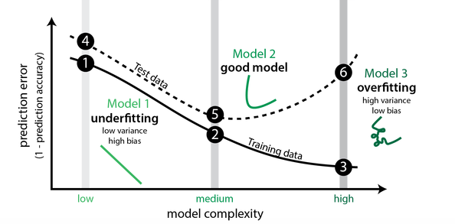
Model Validation

Slide 11
How to Prevent
Underfitting and Overfitting?
Choose the Best Model

Slide 12
How to Prevent
Underfitting and Overfitting?
Choose the Best Model
HOW??

Slide 13
Choose the Right Validation Method

Slide 14
Type of Validation Method
Train and Test Sets.
K-fold Cross Validation.
Leave One Out Cross Validation.
Source : https://machinelearningmastery.com/evaluate-performance-machine-learning-algorithms-python-using-resampling/

Slide 15
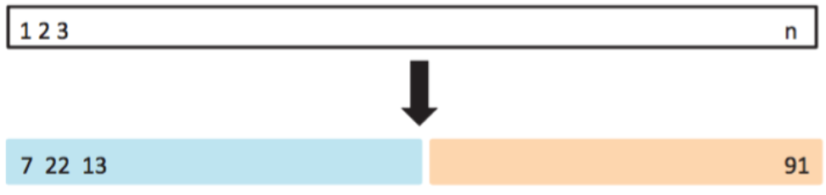
Train and Test Sets
It involves randomly dividing the available dataset of observations into two parts.
A training set
A validation set or hold out set

Slide 16
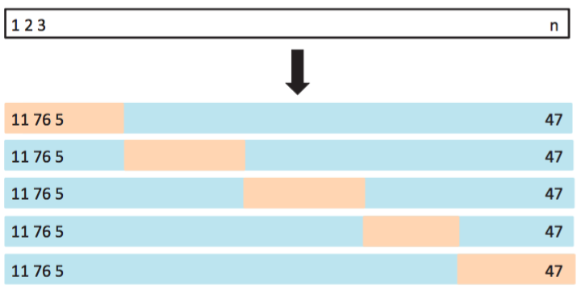
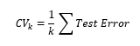
k-Fold Cross Validations
This approach involves randomly dividing the set of observations into k groups, or fold, of approximately equal size.
The first fold is treated as validation set, and the method is fit on the remaining k-1 folds.
The k-fold CV estimate is computed by averaging these values

Slide 17
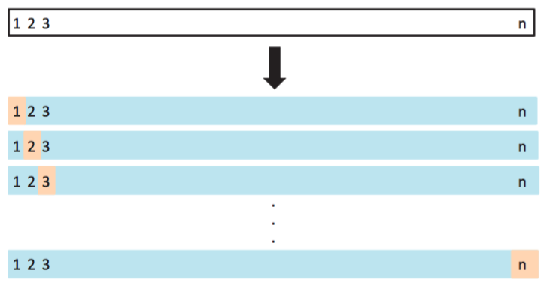
Leave One Out Cross Validation
You can configure cross validation so that the size of the fold is 1 (k is set to the number of observations in your dataset). This variation of cross validation is called leave-one-out cross validation.
The result is a large number of performance measures that can be summarized in an effort to give a more reasonable estimate of the accuracy of your model on unseen data. A downside is that it can be a computationally more expensive procedure than k-fold cross validation.

Slide 18
What Techniques to Use When
Generally k-fold cross validation is the gold-standard for evaluating the performance of a machine learning algorithm on unseen data with k set to 3, 5, or 10.
Using a train/test split is good for speed when using a slow algorithm and produces performance estimates with lower bias when using large datasets.
Techniques like leave-one-out cross validation can be useful intermediates when trying to balance variance in the estimated performance, model training speed and dataset size.
The best advice is to experiment and find a technique for your problem that is fast and produces reasonable estimates of performance that you can use to make decisions. If in doubt, use a combination of train/test split(80:20) and 10-fold cross validation.

Slide 19
Choose the Right Hyperparameter Model

Slide 20
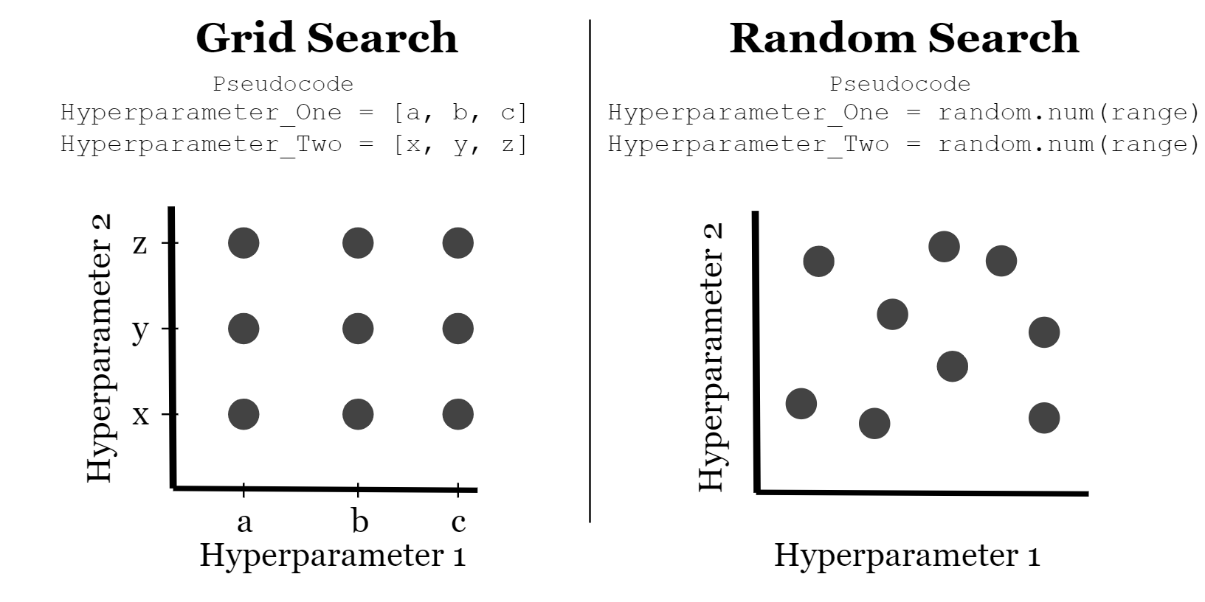
Tunning Hyperparameter
Hyperparameter tuning is choosing a set of optimal hyperparameters for a learning algorithm

Slide 21
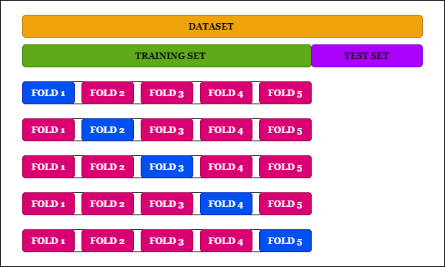
Tunning Hyperparameter+CV

Slide 22
Metrics Evaluation

Slide 23
What is The Good Measure of
“Model Quality” from
Machine Learning Standpoint?

Slide 24
Measure of Models Error

Slide 25
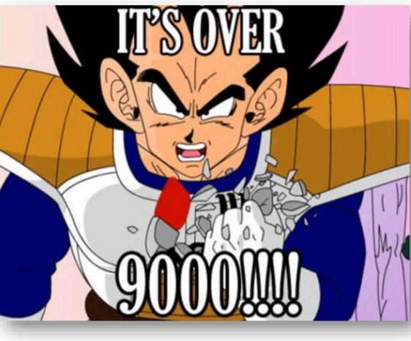
Accuracy
Accuracy is GOD
Include Target Column as Features
For classification : Only check global accuracy
Use old algorithm

Slide 26
Accuracy Paradox
Recurrence of Breast Cancer
Total Observation : 286
Actual (Imbalance Datasets)
Recurrence : 85
No Recurrence : 201
We want to build machine learning model to predict recurrence of breast cancer

Slide 27
Accuracy Paradox
Predict All No Recurrence : (Accuracy : 70.27%, Recall : 0%)
 |  | Predicted
 |  | Recurrence | No Recurrence
Actual | Recurrence | 0 | 85
 | No Recurrence | 0 | 201
Predict Using Decision Tree (Accuracy : 69.23%, Recall : 11.76%)
 |  | Predicted
 |  | Recurrence | No Recurrence
Actual | Recurrence | 10 | 75
 | No Recurrence | 13 | 188

Slide 28
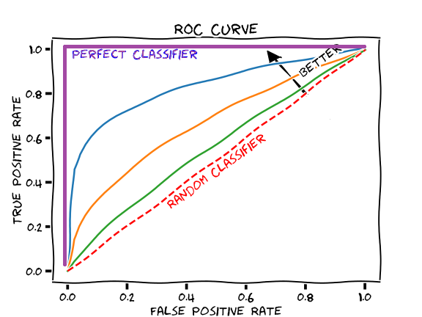
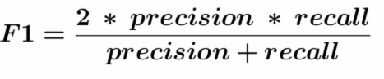
Metrics for Imbalance Dataset
AUC of ROC :
F1-Score :

Slide 29
Thank You

